Slide 1
Introduction to ML project with Colab
AI for Healthcare

Slide 2

Colab
is a product from Google Research. Colab allows anybody to write and execute arbitrary PYTHON code through the browser, and is especially well suited to machine learning, data analysis and education.

Slide 3
IMPORTANT!
PLEASE VISIT THIS WEBSITE TO UNDERSTAND HOW TO USE COLAB
https://shorturl.at/AF135

Slide 4
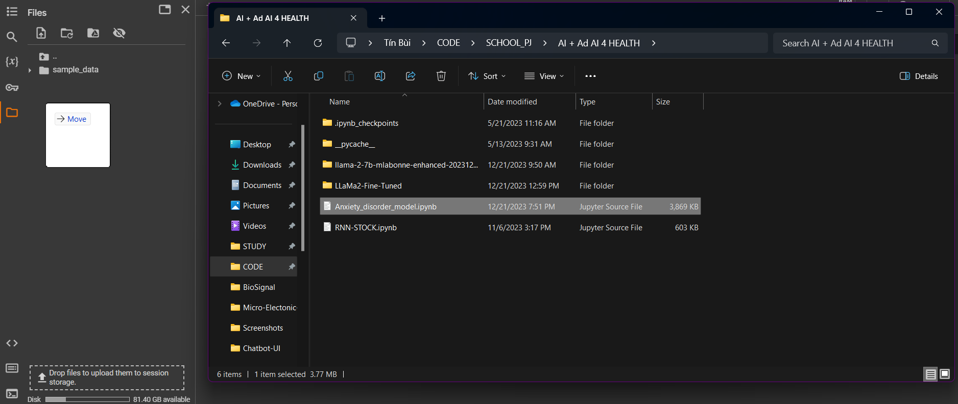
How to upload a file
Just open folder then drag and drop file to this

Slide 5
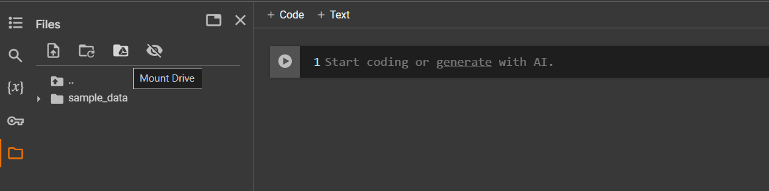
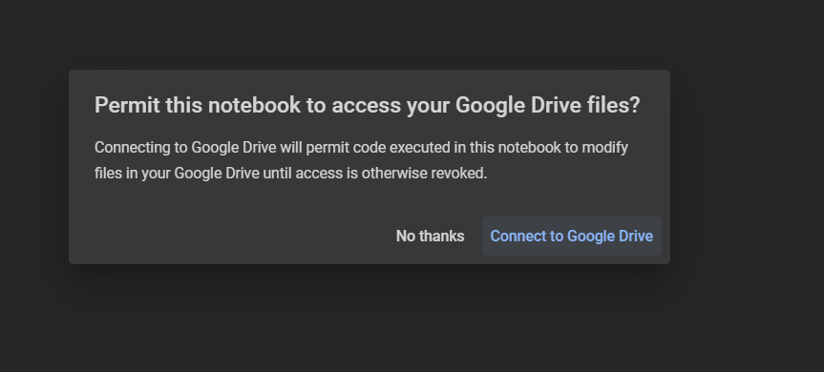
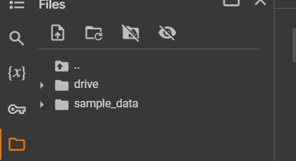
How to take file from Drive
Click this icon
Connect
Success
Note: It will take a bit to connect

Slide 6
How to import libraries
GOOGLE SEARCH
Example:

Slide 7

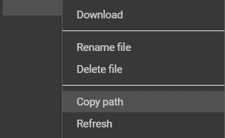
How to take file path
Click 3 dots on the file
Choose “Copy path”

Slide 8
NOTE!
You need to import library and take correct file path to run your code

Slide 9
Now you know how to use colab!
Let go to a ML project

Slide 10
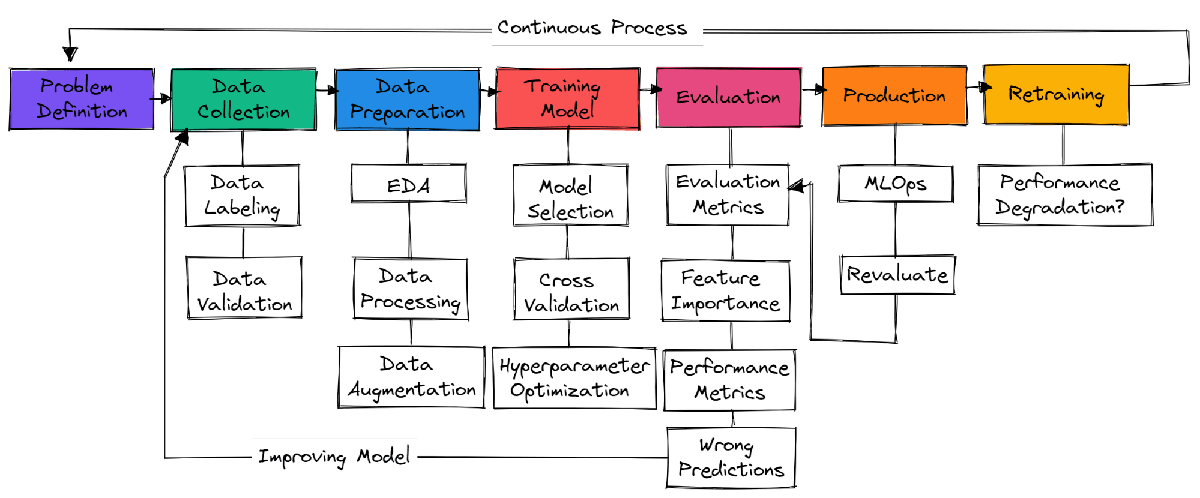
Machine Learning Project in Real-Life

Slide 11
Machine Learning Project in THIS COURSE

Slide 12
Let’s practice!

Slide 13
https://colab.research.google.com/drive/1QNUJTi7krKJ1zg04w8uyJ0wjN0M1MQB0#scrollTo=PSiIoHesSL6Q

